Slide 1
Provost Report
Dr. Robert J. Marley
Provost and Executive Vice Chancellor for Academic Affairs
Faculty Senate Meeting March 24, 2016

Slide 2
Agenda
Updates
Deans Resource Task Force
Federal Agency Repayment
Budget Open Forum Follow-Up
Faculty Salary Incentive Policy

Slide 3
Deans Resource Task Force Charge
To determine responsibilities of the Deans’ Offices in funding activities
Permanent and one-time
To determine “right size” for this responsibility (budgetary)
To determine sources

Slide 4
Deans Resource Task Force Membership List
Robert Marley, co-chair
Walt Branson, co-chair
Mariesa Crow
Anthony Petroy
Tracy Primich
Steve Roberts
John Myers
Jim Drallmeier
Wayne Huebner
Kris Swenson
VA Samaranayake
Lisa Cerney, ex-officio
Mary Jo Richards, ex-officio

Slide 5
Federal Agency Repayment
Based upon feedback from multiple constituencies, including chairs, a fund from the Springfield program that had a sufficient carryforward balance was identified.
No other encumbrances on these funds
Portion of carryforward from used—planned expenditures protected

Slide 6
Budget Open Forum Follow-Up

Slide 7
Current Status
System-State Appropriation Request
#1 Capital Priority - Schrenk Hall
2.0% STEM increase
5.0% performance funding increase
50/50 Matching Capital Request - advanced construction and materials lab
Governor’s Budget - 6% including 1% STEM
House Budget
S&T, UMKC, STL - 0% Increase
MU - $1,000,000 Reduction
System - $7,600,000 Reduction (50%)
No Capital projects included
Tuition and fee recommendations go before Curators in April/June
Accommodate drop in non-resident graduate students

Slide 8
POSSIBLE
FY17 FUNDING SCENARIO
Revenue
State Appropriations $ 0
Tuition and Fee Revenue (with proposed increases) $ 5,116,000
Indirect Cost Recovery $ (500,000)
Adjustment for FY16 Revenue Under Budget $ (2,316,000)
(R/N Undergrad and R/N Graduate revenue is below budget)
(Student fees are below budget, as well)
Adjusted Revenue $ 2,300,000
Expenses
P&T, Insurance, Maintenance and Repair $ (800,000)
Potential System Reduction Impact $ ???
Fair Labor Standards Act Impact (~$26,000 to $50,000) $ ???
(effective October 1, 2016)
Salary & Wage Increase $ ???
Additional Strategic Investments $ ???
Estimated Available Operation Funds (without reallocations) $ 1,500,000

Slide 9
Faculty Salary Incentive Policy
Task force submitted the policy to the Provost for review.
Policy submitted to UM System HR and Finance for preliminary, comprehensive review.
Preliminary approval has just been granted
Chairs will circulate to faculty for comments.
Task Force has thoroughly explored options
Final version planned for submission in mid-late April

Slide 10
Faculty Salary Incentive Task Force Membership List
Daryl Beetner, Chair
James Drallmeier
Suzanna Long
Yinfa Ma
Jagannathan Sarangapani
Stephan Clark
Philip Whitefield
Mary Jo Richards, Ex-Officio
Ryan Rapp (UM audit), Ex-Officio

Slide 11
Division Updates

Slide 12
College of Arts, Sciences, and Business
Bonnie Bachman (Economics) received the Faculty Experiential Learning Award
Shannon Fogg (History and Political Science) was named to the editorial board of the journal French History
Michael Bruening (History and Political Science) has been awarded a 2016–2017 Fulbright U.S. Scholar grant for France
Honglan Shi (Chemistry) has received funds totaling $20,042 from Missouri Water Resources Research Center for the project entitled, “Technology Assistance to Missouri Utilities to Meet DBP Standards: Hannibal, Perryville, Poplar Bluff”

Slide 13
College of Arts, Sciences, and Business
Faculty Excellence Award Winners
Richard Dawes (Chemistry)
Patrick Huber (History and Political Science)
Faculty Research Award Winners
Ulrich Jentschura (Physics)
Faculty Service Award Winners
Diana Ahmad (History and Political Science
Audra Merfeld-Langston (Arts, Languages, and Philosophy)
Jeff Schramm (History and Political Science)
Faculty Teaching Award Winners
Michael Bruening (History and Political Science)
Eric Bryan (English and Technical Communication)
Irina Ivliyeva (Arts, Languages, and Philosophy)
David Wright (English and Technical Communication)

Slide 14
College of Engineering and Computing
Dr. Matt O’Keefe has been named the department chairmen for Materials Science and Engineering.
Missouri S&T's Gamma Theta Chapter of HKN (the ECE Honor Society) was given the Outstanding Chapter Award. The award was given to 22 of the hundreds of chapters internationally. This is the 14th year in a row Missouri S&T has won the award.
Best Paper Award: Luo, J., Gilbert, L., Bristow, D. A., Landers, R. G., Goldstein, J., Urbas, A. and Kinzel, E. C., “Additive Manufacturing of Glass for Optical Applications,” Best Paper Award, 2016 SPIE – Photonics West, San Francisco, CA, February 13 -18, 2016.
Dr. Mariesa Crow, the Fred Finley Distinguished Professor of Electrical Engineering, will deliver a guest lecture at the University of Tennessee-Knoxville’s College of Engineering as part of its Distinguished Lecture Series. Crow will present “VRB Energy Storage Performance Characterization for Microgrid Applications.”
Engineering Management and Systems Engineering’s IIE Chapter has been listed in the “Top University Chapters With 50 or More Members”.

Slide 15
College of Engineering and Computing
Dr. David C. Van Aken, Curators’ Teaching Professor of materials science and engineering, and Dr. Julia E. Medvedeva, associate professor of physics, received second place in the 2016 AIST Hunt-Kelly Outstanding Paper Award, presented by the Association for Iron and Steel Technology.
They worked with alumni Krista R. Limmer, who earned a Ph.D. in materials science and engineering in 2014, and Scott T. Pisarik, who earned a bachelor of science degree in 2012 and a master of science degree in 2014, both in metallurgical engineering. The four received the recognition for the paper “Developing a Third-Generation Advanced High-Strength Steel With Two-Stage TRIP Behavior.”
Dr. Daniel B. Oerther, the John A. and Susan Mathes Chair of civil, architectural and environmental engineering, has earned the Superior Achievement Award from the American Academy of Environmental Engineers and Scientists (AAEES) for his work to improve water quality in the Ixcan region of Guatemala.
Dr. Suzanna Long, interim chair and associate professor of engineering management and systems engineering, and Dr. Cihan Dagli, professor of engineering management and systems engineering, were recently named to onlineengineeringprograms.com’s list, “20 Systems Engineering Professors to Know,” for their achievements in advancing the field of systems engineering.

Slide 16
College of Engineering and Computing
Dr. Curt Elmore, professor of geological engineering, was one of the recipients of the Service Learning Award. Elmore was recognized for his work to establish Missouri S&Ts humanitarian engineering and science minor program.
The Service Learning Award recognizes faculty and staff who involve or influence undergraduate students in academic service learning or community service activities outside the classroom.
CEC Faculty and staff advisors to registered student organizations were recently recognized at the fifth annual Advisor Awards Breakfast:
Erika Garcille, business operations associate I, earned Outstanding New Advisor of the Year for Gamma Rho Lambda
Dr. Sajal K. Das, professor and chair of computer science and the Daniel C. St. Clair Endowed Chair in computer science, earned Outstanding Advisor of the Year for computer science
Dr. Von Richards, professor of materials science and engineering, earned the Distinguished Advisor Award for the American Foundry Society and David Hoffman, volunteer in civil, architectural and environmental engineering, earned a Student Affairs Award for Meritorious Service to Student Organizations for Engineers Without Borders
Air Force ROTC Cadets Thomas Enloe and Carl Herrmann were awarded the Society of American Military Engineers (SAME) award for their distinguished accomplishments.

Slide 17
Office of Undergraduate Studies
Student Design and Experiential Learning Center Competitions
Baja SAE Racing, Baja SAE Tennessee at Tennessee Tech, April 14-17
Concrete Canoe, ASCE Mid Continent Regional Comp in Rolla MO, April 21-23
Steel Bridge, Mid-Continental ASCE Regional Steel Bridge Comp at S&T, April 21-23
Human Powered Vehicle, HPVC West in San Jose CA, April 22-24
Hit the Ground Running
July 10th – 29th, 2016
Consists of Math, Chemistry*, English & a Student Success Course
Students Register for HGR when they attend PRO
Scholarships are available
Missouri S&T Undergraduate Research Conference
April 11th, 2016
Keynote Speaker, Joel Burken
Curators’ Professor & Interim Chair of Civil, Arch & Environ Engr

Slide 18
Office of Graduate Studies
Technical Editing
16 submissions have been edited (a total of 261 pages) as of 2/23/16
3 writing workshops have been planned for the SP 2016
2 Thesis/Dissertation Boot Camps have been scheduled for SP 2016
The 7th Annual Graduate Fellows Research Poster Session was held on Monday, February 22 with 50 posters presented.
The Awards Banquet for the winners of the Poster Session was held on March 7th. The following awards were given:
1st Place- Cory Reed, Geosciences and Geological and Petroleum Engineering
2nd Place- Michael Wisely, Computer Science
3rd Place- Kenneth Campbell, Civil, Architectural and Environmental Engineering
3rd Place- George Shannon, Engineering Management and Systems Engineering
Honorable Mention- Erica Ronchetto, Materials Science and Engineering
Honorable Mention- Jordan Wilson, Civil, Architectural and Environmental Engineering
Over 900 graduate applications have been processed in 2016 as of March 3.
The second conference of the 2016 Graduate Leadership Development Program (GLDP) met at UMKC on March 10-11.
This conference focused on entrepreneurship and management.
The Graduate Faculty Council Annual Awards Banquet will be held April 29th

Slide 19
Enrollment Management
Thank you to everyone that helped with the February 15 Open House. Next Open House is March 25.
VEX Robotics (Feb 20) and FRIST Robotics (Mar 5) Championship competitions went well with over 2,500 visitors to campus.
Open House for the new Student Veteran Resource Center which is located in the basement of the Baptist Student Union was held on March 19.
New undergraduate student projections show 1,520 freshmen and 430 transfers. This is a 2% increase over last year.

Slide 20
Office of Sponsored Programs
Summary of FY16 activities year-to-date (December)
Number of funded proposals up 35% for a total of 155
Total dollars is $18.4M which is down 8.1%
Number of new proposals submitted is up 2% at 262
Total dollars is $76.2M which is down 6.2%
Number of active awards is down by 1% at 608
Total expenditures is $19M which is down 3%
Net grant and contract expenditures is $15M which is down 5%
F&A recovered is $3M which is down 11.2%

Slide 21
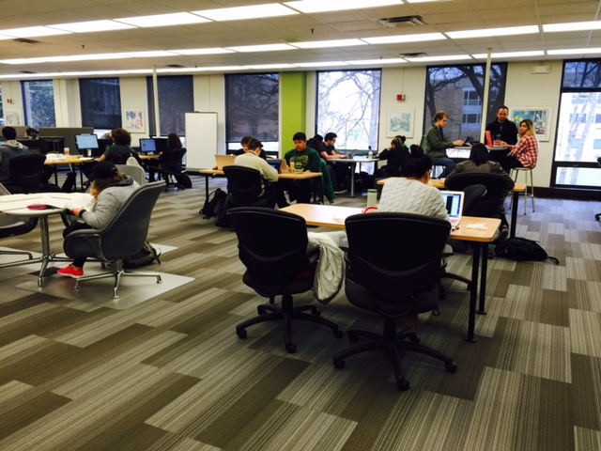
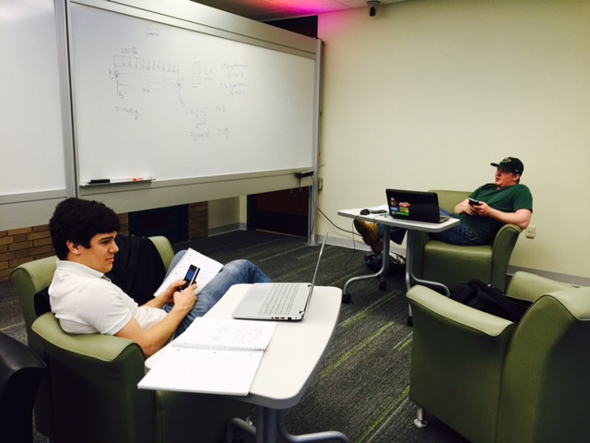
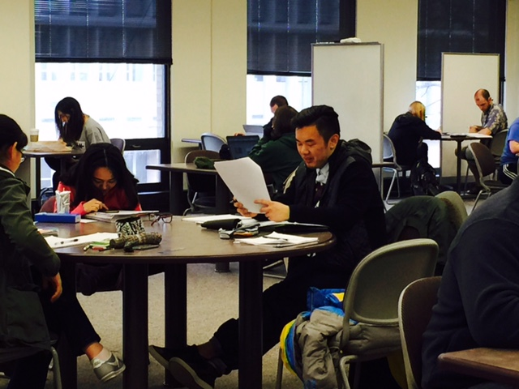
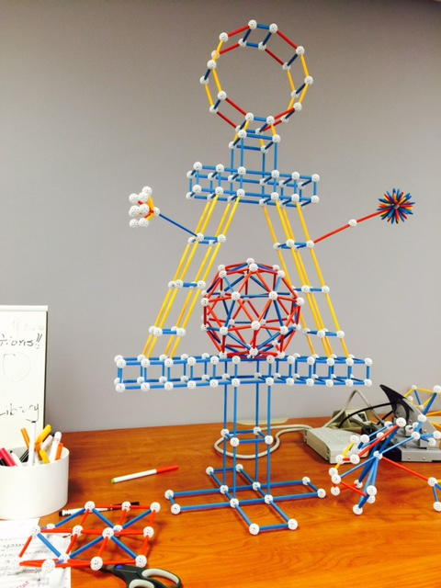
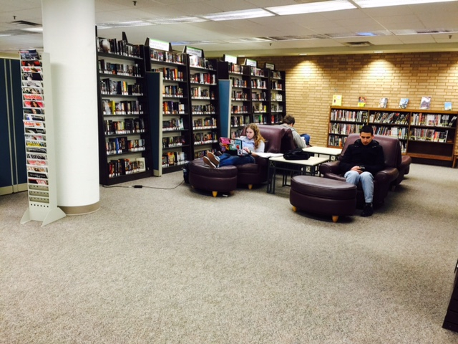
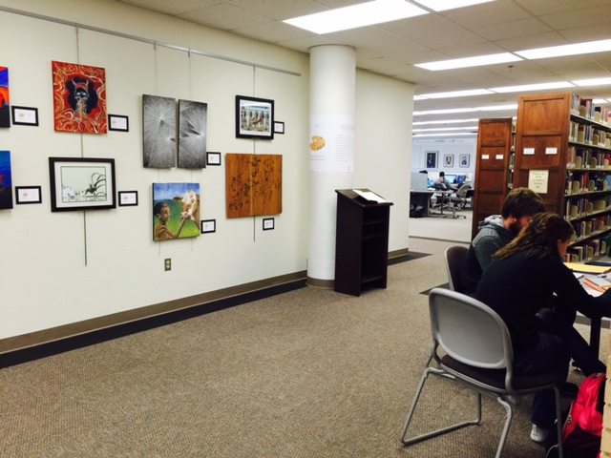
Curtis Laws Wilson Library
BuiCurtis Laws Wilson Library
Curtis Laws Wilson Library
Build it and they will come.
Expanded seating in the library, starting January, 2016. Metrics available!

